Slide 1
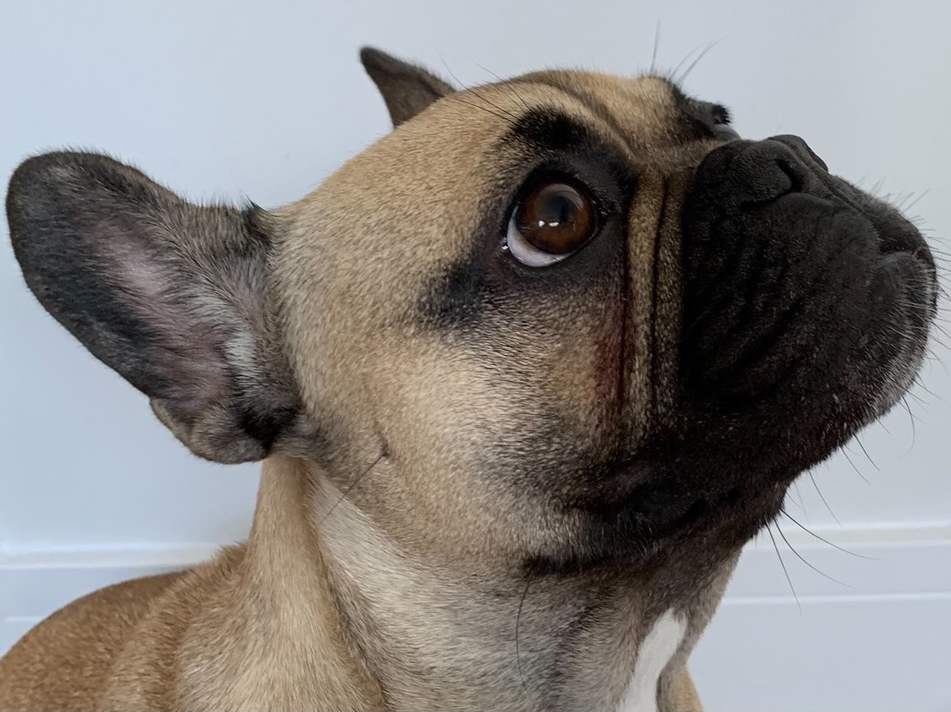
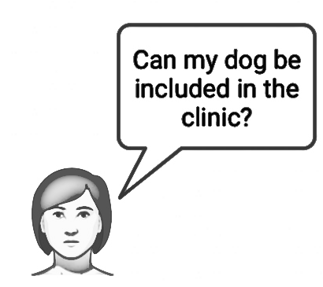
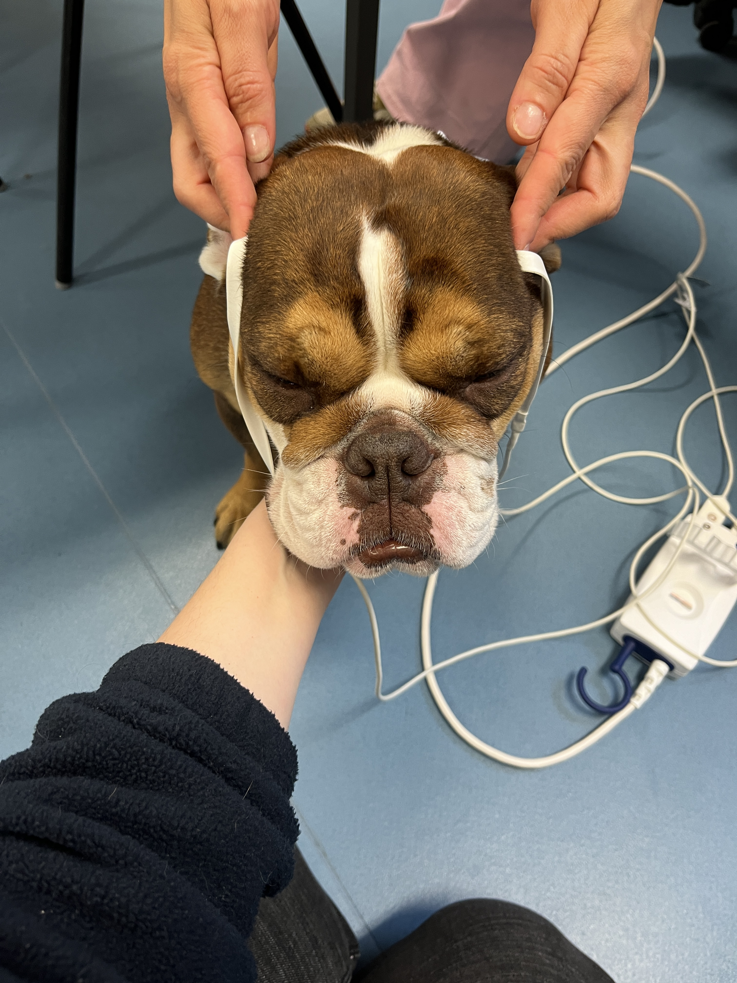
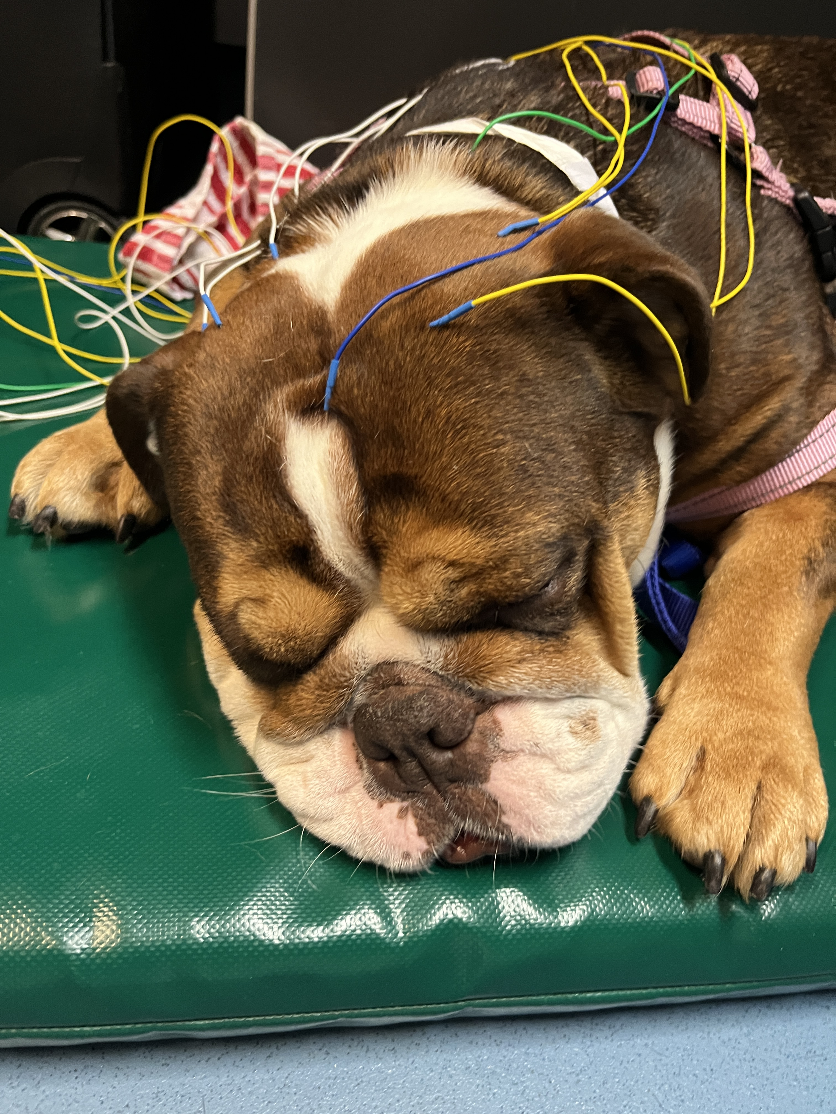
Uncovering the effect of BOAS in the brain
The Queen’s Veterinary School Hospital
The ‘BBB’ clinic
‘Brachycephalic Breathing Brain’
Brachycephalic Obstructive Airway Syndrome (BOAS) affects a high percentage of Pugs, French bulldogs and English bulldogs.
BOAS dogs have more signs of brain dysfunction. Is this because of the decreased brain oxygenation?
If this is true, can we prevent / treat the brain disease by addressing the BOAS?
Your dog will have the following investigations (all minimally invasive and free of charge):
Neurological assessment, collection of mouth swab for genetics, brain oxygenation assessment with sensors (NIRS) and collection of samples to check natural bacteria.
If your dog needs BOAS surgery, optional investigations could include:
Results from optional pre-anesthetic blood test
Brain wave measurement (EEG) when asleep
Needs to be a pug, French bulldog or English bulldog
Has brain signs such as seizures or other ‘funny turns’
Known BOAS grade (this can also be done during the general evaluation of the dog)
NIRS
EEG
Contact us today!: bbbneuro@vet.cam.ac.uk (Dr Susana Monforte and Dr Lisa Alves)

