Slide 1
First year reports, MPhils and PhD theses: formalities of submission
David Sargan: June 2016
with thanks to Sarah Pickard (registry)
Notes:
I am going to be addressing different remarks to different groups in the audience – bear with me – some of the advice applies to both sections.

Slide 2
First year assessment – what is required
Assessment process requires a written report
form is of extended scientific paper
an introduction:states area of work with condensed literature review
aims
materials and methods
results – may be extensive or less so
discussion – including objectives and timescales
length
varies in different departments: VetMed keeps it short. 8000 words maximum
some Depts also ask for a talk as a formal part of assessment
we ask for a talk and/or poster at other times – not a formal part of assessment

Slide 3
First Year Assessment: when
Hand-in date also varies between Departments
Most (including VetMed) but not all suggest end of tenth month of first year:
i.e. end of July for Oct starts, end of Oct for Jan starts, end of Jan for April starts
If you collected & analysed data as you went this short report should not take long to write.
do not let it dominate your programme
writing the first draft should not take more than two-three weeks
Notes:
BBSRC DTP get extra time

Slide 4
First Year Assessment: when
Before you write, discuss with your supervisor
find two assessors. They may be internal to the Dept but should not be connected closely with the project
make sure they are available in the two-three weeks after you expect to hand in
discuss a plan of what will be in the report
make sure your supervisor is primed to read a draft and return it to you quickly
nevertheless allow time for this and the resulting corrections
When you are satisfied with the report, make three copies
retain one, give the other two directly to the assessors
remind them that they need to be available to assess you in the next few weeks

Slide 5
First year assessment: the assessment
Assessment takes the form of a viva-voce interview lasting ±1 - 1.5h
Assessors write a joint report which they copy to supervisor and graduate office
This includes recommendation for progression, re-assessment or failure
Recommendation for re-assessment usually allows one term to resubmit
Recommendation to failure is unusual
When it occurs candidate is usually invited to write up and submit thesis for MPhil
Supervisor writes a progress report and their own recommendation.
Departmental Graduate Committee reviews reports
If there is a difference between recommendations DGC makes a decision in consultation with supervisor

Slide 6
MPhil and PhD Deadlines
MPhil: minimum three terms in residence
course one “academical” year
We recommend you hand in by end July, but formal position allows student until end August
MPhil: minimum three terms in residence
PhD: Minimum 9 and maximum 12 terms full time
Time is measured from start of probationary PhD, except for those BBSRC students who did MRes
You must submit by end of term twelve, or be removed from the register.

Slide 7
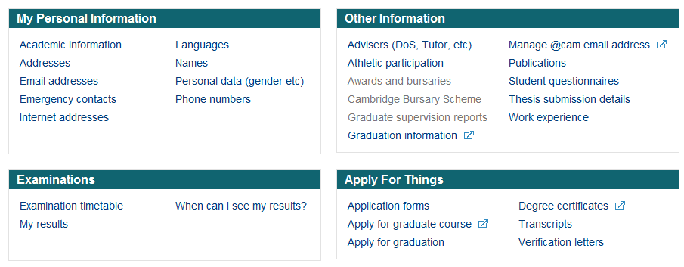
Know your CamSIS self-service

Slide 8
Help, I’m going to overrun !
In consultation with your Degree Committee/Department, the Student Registry, will consider removing you from the register of Graduate Students after 4 years if you don’t submit or have good reason for – and have applied and had an extension agreed by the Student Registry in advance of your end date.
If you are not registered there are implications:
For example:
You are no longer a student
Your student visa will no longer be valid
You start paying Council tax
You start paying student /overseas loans
Not entitled to supervision…
Possibly no access to e-journals due to licensing agreements
Notes:
How do I start?
Big psychological barrier. Write your materials and methods

Slide 9
Extending your ‘End of Registration Date’ (Defer your submission)– things you need to know
Apply via CamSIS self service BEFORE end of your fourth year
Good chance deferral will be granted if you have good reasons
Not normally for more than 2 terms
BUT REMEMBER:
If you have not submitted and leave Cambridge you must either have permission to work away or apply to temporarily withdraw from the register
Considering applying for retrospective permissions such as intermission is not normally possible.

Slide 10
MPhil and PhD – preliminaries to submission
Selection of examiners
A couple of months before submission
Normally one internal to University (outside Dept) and one external.
Decision on who is appropriate is HoD responsibility, but…
A summary is required
One page A4 double spaced
Sent to examiners on appointment

Slide 11
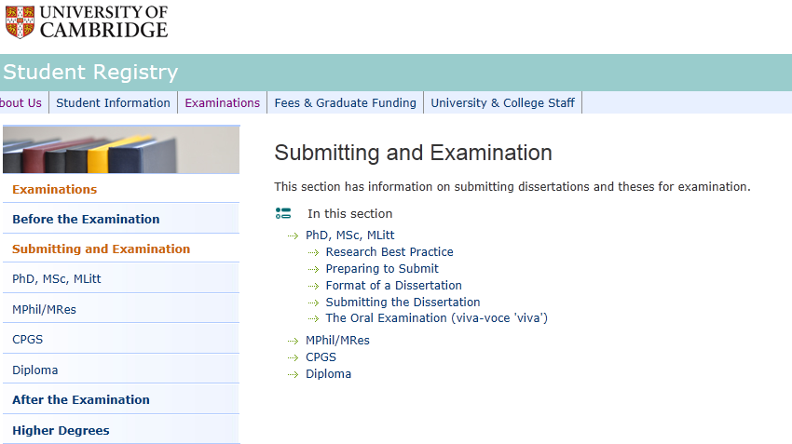
Submitting and examination (PhD or MSc or MPhil/MRes)

Slide 12
Ready for binding: format and style
Word limits
MPhil: 20,000
PhD: 60,000
Can extend
Excludes references, appendices, contents etc
Style & format
Double-sided printing is okay
Submitting a soft-bound dissertation is not a means of submitting a provisional version.
One-and-a-half spaced type. Minimum font size for text is 11pt (12pt is preferred)
Binding
Two bound copies, hard bound or soft bound.
http://www.admin.cam.ac.uk/students/studentregistry/exams/submission/phd/format.html
Notes:
How do I start?
Big psychological barrier. Write your materials and methods

Slide 13
What do I need to submit – It’s all on the Student Registry Website……..

Slide 15
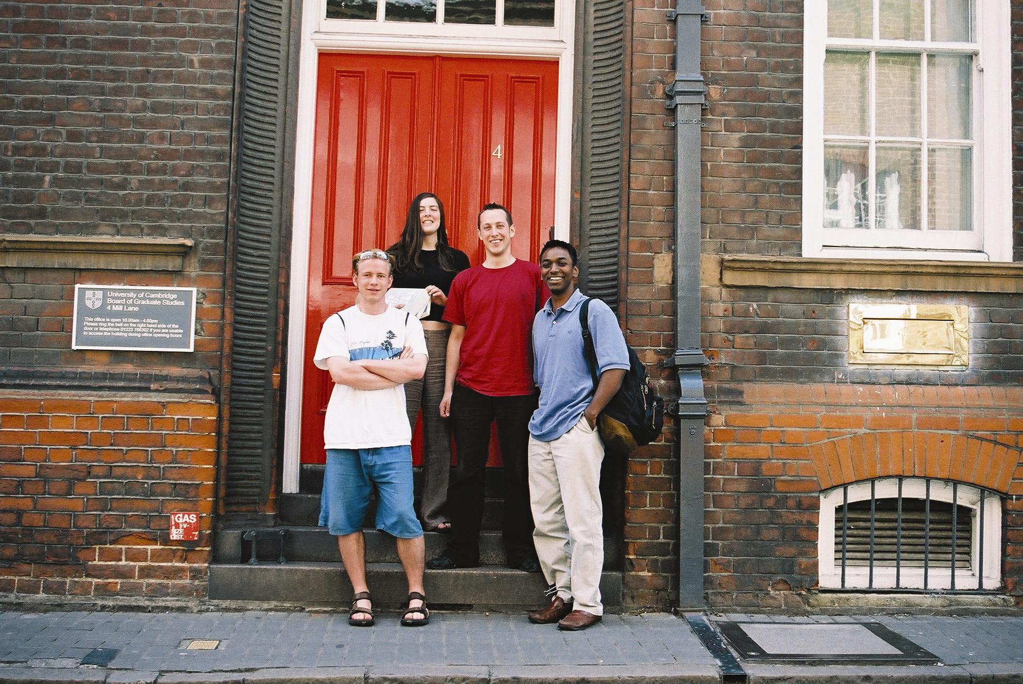
Submitting your dissertation
Go to the
Student Regsitary
(4 Mill Lane)
Outside these hours
use the big brass
letter box
Go to the BGS (4 Mill Lane)
Office hours
10.00 -16.00 Monday-Friday
except Public Holidays
Outside these hours use the big brass letter box to the right of the red front door (put your dissertations in a big envelope first !!)
Office hours
09.00 -17.00
Monday-Friday
except
Public Holidays
to the right of the
red front door
(put your dissertations
in a big envelope first!!)
Notes:
Check the BoGS website!

Slide 16
When submitting your dissertation
Take with you:
Dissertation (two copies)
Title page (two loose copies)
Summary/abstract (three loose copies)
Deposit and Copying of Dissertation Declaration Form
Signed Declaration of your own work/word count
Addresses for Examination Purposes Form
(If you go in office hours, the Student Registry staff will supply any missing forms)
http://www.admin.cam.ac.uk/students/studentregistry/exams/submission/phd/submitting.html
Notes:
Documents are checked at submission – your dissertation cannot proceed to examination without receipt of all the required documents
You will receive a written acknowledgement of the receipt of your dissertation.
The acknowledgement provides further information of what happens next……
Check the BoGS website!

Slide 17
What next……
Your CamSIS record is updated to record submission
Copies of your dissertation go via your Degree Committee to your appointed Examiners
You will be notified of the date of your viva and other information about your examination, usually by the Internal Examiner.
If in doubt check with the Degree Committee

Slide 18
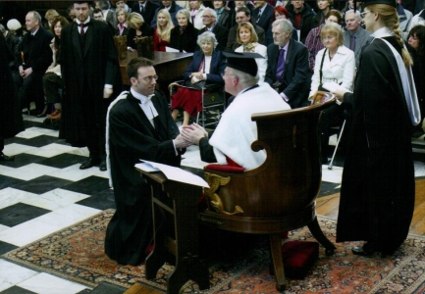
Finally……..Graduation
Your College will manage this – talk to them
When will this be? Dates are published or your College can advise you
You must graduate in order to become a Doctor of Philosophy (this does not happen on approval for the Degree by the Board)
But not necessarily in person

