Slide 1
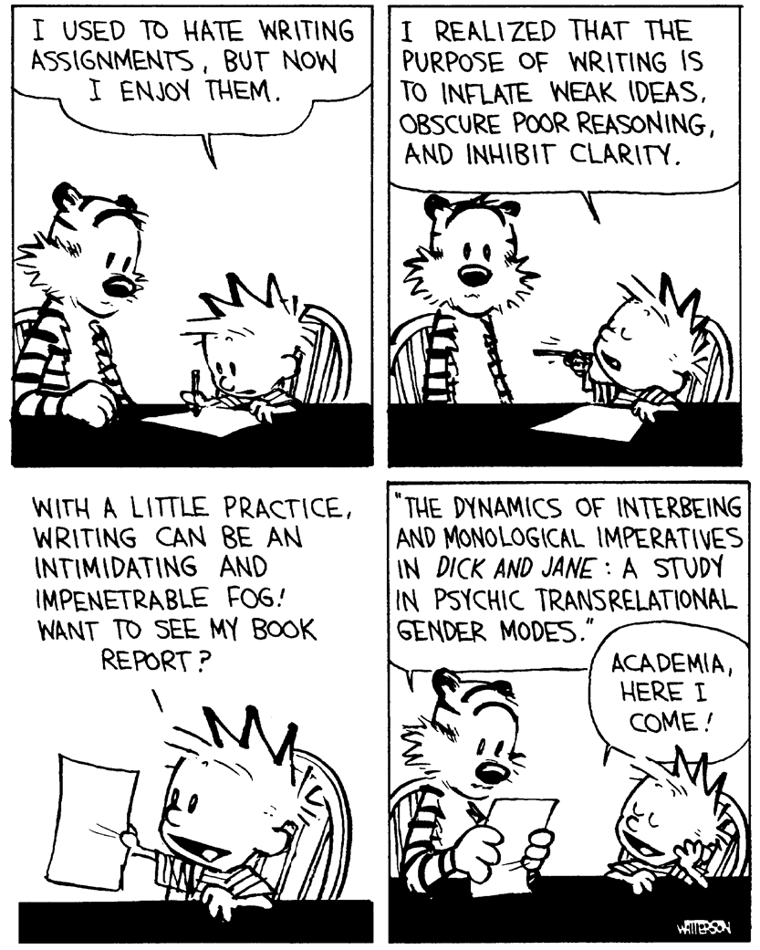
Why?
How?
What?
A crash course in
Scientific writing

Slide 2
Types of Scientific Writing
Thesis
Research Paper
Review Paper
Grant Application
Talk/Presentation
Poster

Slide 3
We are scientists, NOT English majors.
Our job is to communicate our research clearly and accurately,
in a succinct and unambiguous manner.
Why?
How?
What?
Beautiful language is nothing without the Structure and Message

Slide 4
The foundation of scientific writing
Why?
Why are you doing what you are doing?
What is the question?
Introduction
Aims and objectives
How?
Approach
Materials and methods
How have you chosen to answer the question?
What?
What have you found out?
What does this mean?
Results
Discussion

Slide 5
Why?
How?
What?
is a completely scalable concept
Individual
experiments
Projects
Programmes
Careers

Slide 6
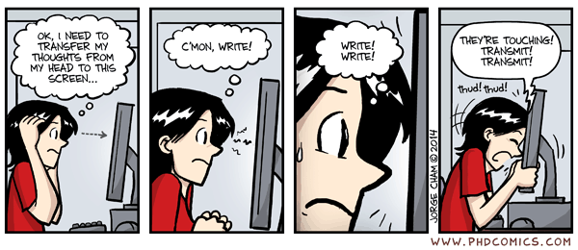
What is the most effective way of producing a scientific document?
A blank screen is daunting to ALL of us, however experienced, however smart.
Do NOT start at the beginning and end at the end.
At best, this is an unfocused waste of time,
at worst, a possible road to ruin.
Compartmentalize your tasks/problems and write in a structured manner.
Remember, you are NOT English majors, and this is NOT creative writing.
This is SCIENTIFIC writing.

Slide 7
Stage 1
Structure and Message
a.) Gather all your possible figures/tables/illustrations
b.) Give them each a title and place them in some order
c.) Write an ‘ABSTRACT’ What is your message? What is your story?
d.) Aims and objectives
e.) Compose your Title
This is the MOST important stage,
so make sure you get feedback
Stay at this stage until you are happy with your structure and message.
Get it right and the rest will *write itself* (so to speak)

Slide 8
Stage 2
Results
a.) Next, write the results as structured in Stage 1.
b.) Title and describe each figure, Why, How, What?
c.) Do they fall naturally into subsections? (I am a HUGE fan of subsections)
d.) Begin to link them together.

Slide 9
AA Deprivation and FTO Protein Levels
Why
Genetic variation – FTO – Obesity; Fasting reduces
FTO expression. Why? Nutrients? Glucose? Amino acids?
In order to determine…
How
Use 3 cell-lines; Amino acid starved;
FTO measured by Western blot.
We used/did/performed/
measured…
What
Amino acid starvation reduces FTO protein levels
in 3 different cell-lines.
We found that…
This means…..

Slide 10
Stage 3
Introduction
a.) Based on the sub-structure of the results in Stage 2, begin the introduction
b.) Each results ‘sub-section’ will require a point in the introduction
c.) Write a few sentences for each point
d.) Begin to link them together.
e.) You AIMS/Objectives and approach to addressing these will end the introduction

Slide 11
Stage 4
Discussion
a.) Only begin the Discussion section once you are happy with your results and intro
b.) Each results/intro ‘sub-section’ will require a point in the discussion
c.) Write a few sentences for each point
d.) Begin to link them together.
e.) Your Summary, conclusion and future work will end the discussion.

Slide 12
Stage 5
Linking, Continuity and Referencing
a.) Link all of the sections coherently together
b.) If its in you, now would be a good time for your inner Shakespeare to emerge
c.) Now, reference your document (doing it before is a waste of time)
d.) Proof

Slide 13
For papers, simply apply Stages 1-5.
For your Thesis however, you will need to apply Stages 1-5 in two stages.
Stage 1
Stage 3
Stage 2
Stage 4
Title
Abstract
General
Introduction
Results
Chapters
General
Discussion
a.) Start with Stage 1 for your WHOLE thesis
b.) Each of your results chapters will have its own
Abstract, intro, results, discussion (Why, How, What)
c.) Apply Stages 1-5 for each chapter.
d.) When each chapter is complete, these will fit into
Stage 2 of your WHOLE thesis Stage 1-5.
Each individual
results chapter
S1. Title/Abstract
S3. Introduction
S2. Results
S4. Discussion

Slide 14
Types of Scientific Writing
Thesis
Research Paper
Review Paper
Grant Application
Talk/Presentation
Poster

Slide 15
Review paper
S1. Title/Abstract
S2. Assemble key papers and write a paragraph summarizing each paper
(don’t over think this stage. Just summarize the key points)
S3. Order your different summaries into the structure, initially as suggested in the
abstract. Remember to use subheadings to tell your story. Be flexible about
changing the structure as necessary, in order to put across your intended message,
tweaking your abstract as you go along.
S4. Begin to fix the continuity between you different summaries and sections.
S5. Polish and reference.

Slide 16
Why?
How?
What?
Questions?

